Slide 1
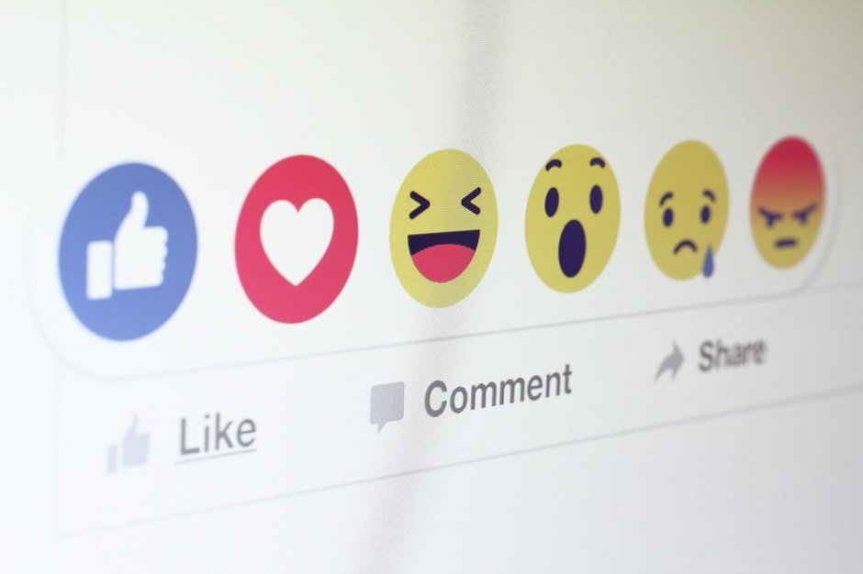
TOXIC COMMENT CLASSIFICATION
Project by:
Sonika Prakash
Poornima G B
Spoorthy R S
Ramyashree G T
Anu Bai B

Slide 2
INTRODUCTION
Nowadays, the flow of data over the internet has grown dramatically, especially with the appearance of social networking sites. Social networks sometimes become a place for threats, insults, and other components of cyber bullying.
A huge number of people are involved in online social networks. Hence, the protection of network users from anti-social behavior is an important activity.
One of the major tasks of such activity is automated detection of the toxic comments. Toxic comments are textual comments with threats, insults, obscene, racism, etc.
In recent years there have been many cases in which authorities arrested some users of social sites because of the negative (abusive) content of their personal pages.

Slide 3
THE END
Thank You!

